Slide 1
Federal Update
Jeff Baker, Federal Student Aid
U.S. Department of Education
April 2015

Slide 2

ATB and Career Pathway
Programs

Slide 3
ATB and Career Pathway Programs
(Consolidated and Further Continuing Appropriations Act, 2015)
Establishes Ability-to-Benefit alternatives for students without a high school diploma, or equivalent (or home schooled) who are enrolled in an eligible “Career Pathway” “Program”.
ATB –
  Pass an ED approved ATB test
  State Process (none have ever been submitted)
  Complete six credit hours (or equivalent)
Beginning July 1, 2015, reduced Pell Grant payment schedule

Slide 4
ATB and Career Pathway Programs
Career Pathway Program:
  Concurrently enrolls students in “connected adult education” and an eligible Title IV academic program
  Provides counseling and supportive services
  Provides “structured course sequences”
  Provides opportunities for acceleration
  Organized to meet the needs of adults
  Aligned with the education and skill needs of the regional economy
  Developed in collaboration with business, workforce development, and economic development.

Slide 5
2015-2016 Pell Grant Payment Schedules
(DCL GEN-15-2)

Slide 6
2015-2016 Pell Grant Payment Schedules
Maximum Scheduled Award of $5,775: Increase of $45 from the $5,730 maximum award for the 2014-2015 Award Year.
Maximum Pell Grant eligible EFC for 2015-2016 will be 5198.
Minimum award amount is $588 not $577 because of mid-points in all cells of the schedules

Slide 7
Sequestration

Slide 8
Sequestration - Grants
TEACH Grant awards reduced by 7.3% for FY 2015 (first disbursed between October 1, 2014 and September 30, 2015).
Iraq-Afghanistan Service Grant awards reduced by 7.3% for FY 2015 (first disbursed between October 1, 2014 and September 30, 2015).
Revised percentages for awards first disbursed on or after October 1, 2015 were published last week.

Slide 9
Sequestration – Direct Loan Fees
Subsidized Loans and Unsubsidized Loans –
  1.073 percent for loans first disbursed on or after October 1, 2014 and before October 1, 2015.
  1.068 percent for loans first disbursed on or after October 1, 2015 and before October 1, 2016.

Slide 10
Sequestration – Direct Loan Fees
PLUS Loans (Parent and Grad Student) –
  4.292 percent for loans first disbursed on or after October 1, 2014 and before October 1, 2015
  4.272 percent for loans first disbursed on or after October 1, 2015 and before October 1, 2016

Slide 11
Interest Rates

Slide 12
Interest Rates
  Annual fixed rates based on 10 Year T-Bill, plus add-on.
  Applies to loans first disbursed between July 1 and June 30.
  Rate applies for the life of the loan.
  Add-ons and caps–
    Undergraduate Sub and Unsub: 2.05/8.25%
    Graduate Unsub: 3.60/9.5%
    PLUS Loans: 4.60/10.5
12

Slide 13
2014-2015 Interest Rates
  Undergraduate Students - Sub and Unsub
      4.66% compared to 2013-2014 rate of 3.86%.
  Graduate students – Unsubsidized Loans
      6.21% compared to 2013-2014 rate of 5.41%.
PLUS Loans (parent and grad/professional)
    7.21% compared to 2013-2014 rate of 6.41%.
  2015-2016 rates determined in May.
13

Slide 14
Perkins Loan Program
(DCL GEN-15-3)

Slide 15
Perkins Loan Program
  Dear Colleague Letter GEN-15-03
  Absent congressional action the program ends on September 30, 2015
      Schools may not make Federal Perkins Loans to new borrowers after September 30, 2015.
      If prior to October 1, 2015, a school makes the first disbursement of a Federal Perkins Loan to a student for the 2015-2016 award year, the school may make any remaining disbursements of that 2015-2016 loan after September 30, 2015.
15

Slide 16
Perkins Loan Program
  Narrow “grandfathering” provision
    Allows schools to make Perkins Loans to certain students for up to five additional years (through September 30, 2020) to enable students who received loans for award years “to continue or complete courses of study.
    Loans can be made only if all of the following conditions are met:
16

Slide 17
Perkins Loan Program
  The school made at least one loan disbursement to the student on or before June 30, 2015.
  The student is enrolled at the same institution where the last Perkins Loan disbursement was received.
  The student is enrolled in the same academic program (same CIP Code) for which the student received his or her last Perkins Loan disbursement.
  Loan used to meet unmet need only after student has been awarded all Direct Subsidized Loan for which the student is eligible.
17

Slide 18
FSA ID – PIN Replacement

Slide 19
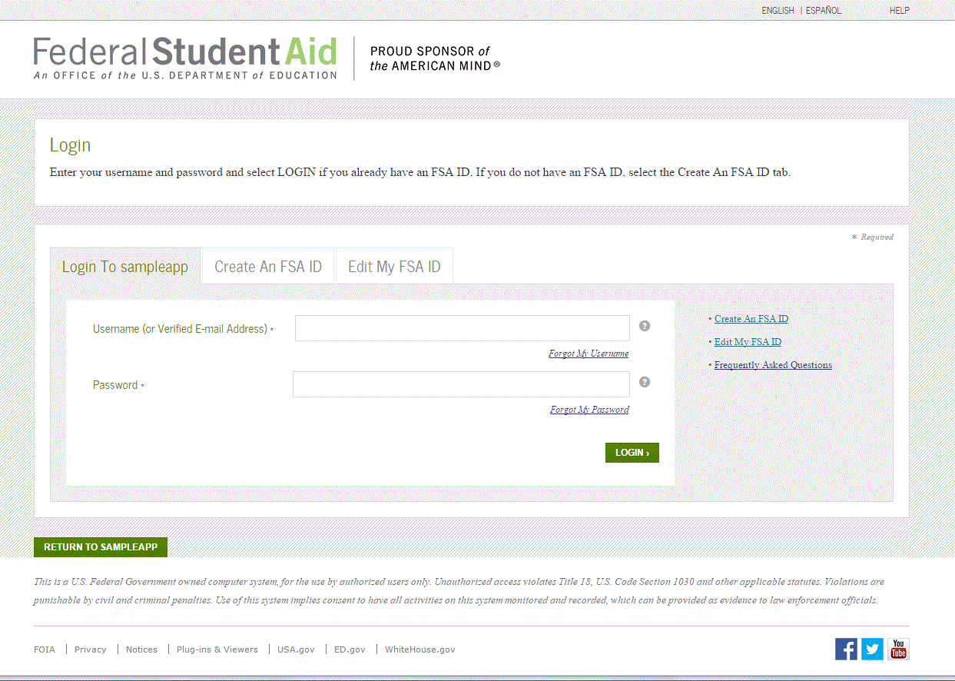
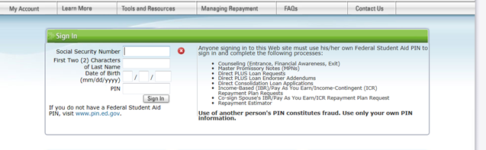
Introducing the FSA ID
The FSA ID will modernize access for students, parents, and borrowers to FSA systems
FSA is adopting the best practice of using a username and password instead of personal information
The FSA ID
  Requires users to enter less information (2 fields instead of 4)
  Provides more secure access to user’s information
  Links to PIN information during registration
  Allows users to update personal information such as last name changes without applying for a new FSA ID (Lifetime ID)
The FSA ID (Username and Password) will replace PIN for students, parents, and borrowers accessing FSA systems starting in late Spring 2015.
New FSA ID login
Old PIN login on Studentloans.gov

Slide 20
Regulatory Update

Slide 21
Violence Against Women Act
Requires institutions to:
  Maintain statistics on dating violence, domestic violence, sexual assault, and stalking
  Provide, and describe in annual security reports, prevention and awareness campaigns
  Provide a prompt, fair, and impartial disciplinary proceeding, and provides for requirements governing that proceeding
  Provide information and support services to victims

Slide 22
Program Integrity and Improvement
  Issues Negotiated:
    Cash management
    State authorization of distance education programs
    State authorization of foreign locations of domestic institutions
    Repeat coursework
    Clock-to-credit hour conversion
    Definition of PLUS adverse credit history

Slide 23
Program Integrity and Improvement
  Four negotiations: Feb. 19 - 21, March 26 - 28, April 23 – 25, May 19 – 20, 2014
  Final regulations on PLUS adverse credit published
  Continuing to work on remaining issues

Slide 24
PLUS Loan Adverse Credit
Definition of PLUS Loan adverse credit history
    NPRM published on August 8, 2014
    Final rule published October 23, 2014
    Applies to both Parent PLUS and Grad PLUS
    Early implementation on March 29, 2015
    See IFAP for implementation webinar

Slide 25
PLUS Loan Adverse Credit
  No adverse credit if total outstanding balance is not greater than $2,085 for debts that are:
    90 or more days delinquent;
    Placed in collections;
    Charged off (written off)
  Borrowers who are eligible because of extenuating circumstances or endorser must complete Department provided counseling before loan can be disbursed.
  Other PLUS Loan borrowers may take counseling

Slide 26
Pay As You Earn Expansion
  Federal Register Notice published Sept. 3, 2014
  We propose to develop regulations that:
  Allow more students the opportunity to cap their monthly student loan payments at 10% and have balance forgiven after 20 years.
  Target the new PAYE option to borrowers who would otherwise struggle to repay their student loans.

Slide 27
Pay As You Earn Expansion
Expansion of PAYE Repayment plan
  Two public hearings held earlier this year in Washington, DC and Anaheim, CA
Negotiating sessions began in February
  Three sessions
  Approximately 3 days each
  At roughly monthly intervals

Slide 28
Gainful Employment

Slide 29
The HEA provides that to be Title IV eligible an educational program must be offered by:
  A public or non-profit postsecondary educational institution and leads to a degree; or
    Generally, all non-degree programs must lead to gainful employment
  Any institution and “to prepare students for gainful employment in a recognized occupation”.
    Generally, all programs must lead to gainful employment

Slide 30
Which Programs are GE Programs
At public institutions and not-for-profit institutions, all non-degree programs are GE Programs except for –
  Programs of at least two years in length that are designed to be fully transferable to a bachelor’s degree program
  Preparatory coursework necessary for enrollment in an eligible program (loan only)

Slide 31
Which Programs are GE Programs
At proprietary institutions, all programs are GE Programs except for –
  Preparatory coursework necessary for enrollment in an eligible program
  Bachelor’s degree programs in liberal arts offered since January 2009 that are offered by a proprietary institution that has been regionally accredited since October 2007

Slide 32
GE Reporting
GE reporting began last week (voluntary)
Report all Title IV Students by July 31, 2015
  Report 2008 – 2009 through 2013 – 2014 award years.
    Programs with Medical and Dental Residencies report 2007 – 2008 through 2013 – 2014 award years.
Report following award years by October.
Data submitted in 2011 will not be available to reuse

Slide 33
GE Data - Students to Include
All Title IV students enrolled in the GE Program
A student enrolled in more than one GE Program must be reported separately for each program.
A student who ‘stopped out’ and re-entered the same GE Program during the same award year must be reported separately for each enrollment.
A student who was enrolled in the same GE Program during multiple award years must be reported separately for each award year.

Slide 34
Verification

Slide 35
Verification – Policy
For the 2012-13 award year retained the long-standing five items and added SNAP and child support paid, if reported on the ISIR
For the 2013-14 award year introduced the concept of verification groups
Added high school completion and identity/statement of educational purpose as verification items

Slide 36
Verification – Policy
For the 2014-15 award year
Eliminated SNAP (V2) as a separate verification group
Added household resources group (V6)
Added other untaxed income and benefits as a verification item
For the 2015-16 award year
  No changes

Slide 37
Unusual Enrollment History (UEH)

Slide 38
UEH – 2015-2016 Changes
Will include Direct Loans in addition to Pell Grants
  No significant increase in numbers expected to be selected
Will look back four years –
  2011-2012, 2012-2013, 2013-2014, and 2014-15
  Addresses one-year drop-outs
  No significant increase in numbers expected to be selected

